Slide 1

Attitude and behaviour: Social Identity Theory
AEPSY Year 11 ATAR Psychology

Slide 2
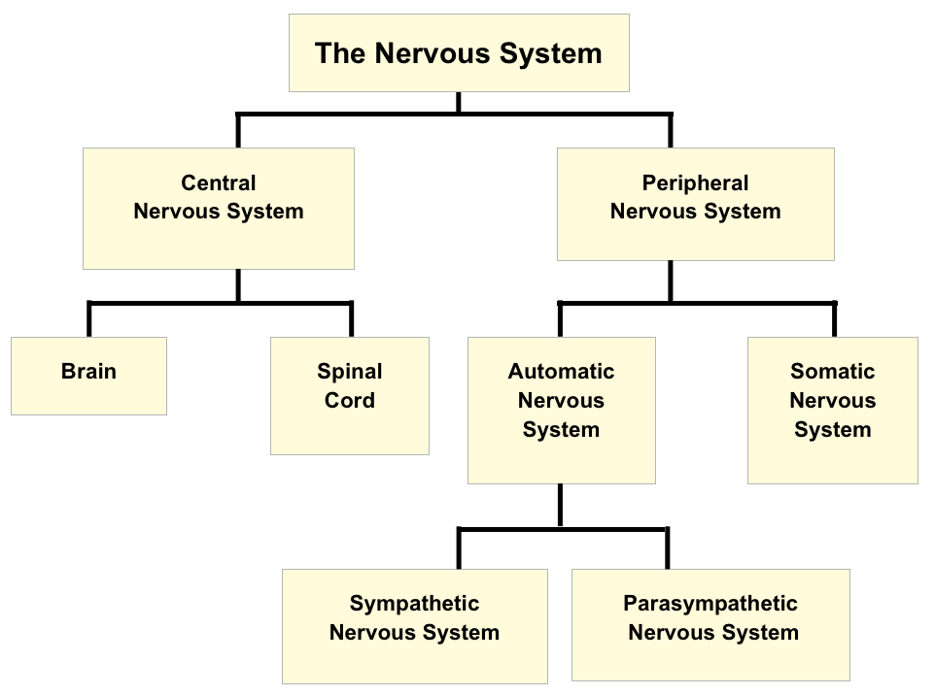

Review
Copy and fill in the blanks:

Slide 3
True or false?
Soma contain the nucleus of the neuron.
Interneurons make up the PNS.
Impulses move from dendrites to axon terminals.
Nerves touch each other.
Nerve transmissions are chemical and synapse transmissions are electrical.
The myelin sheath slows down nerve transmission.
Each neuron contains up to 10 axon terminals.
Interneurons are also called unipolar neurons.

Slide 4
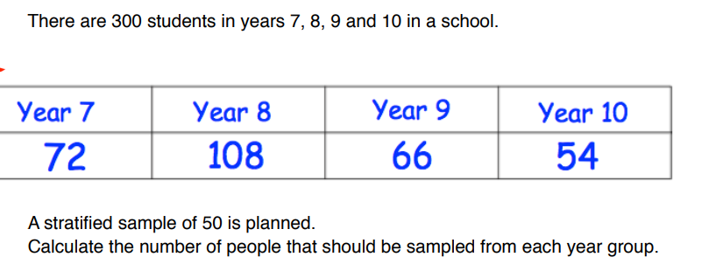
Review

Slide 5
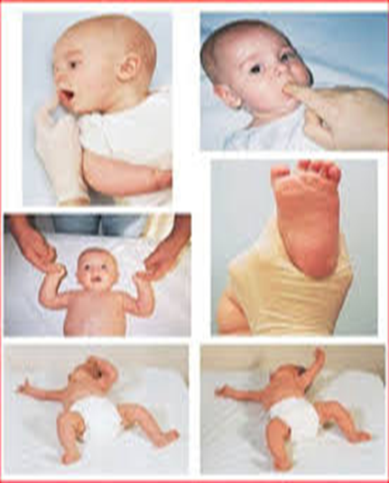
Review
Name three newborn reflexes

Slide 6
Learning Intentions
social identity theory – Tajfel and Turner (1979)
social categorisation, social identification, social comparison

Slide 7
Success Criteria
Summarise Social Identity Theory
List positive and negative effects or examples of SIT
Define social categorisation
Define ingroup and outgroup

Slide 8

Social Identity Theory Tajfel and Turner (1979)
Being part of social groups allows people to feel a sense of social identity, making up part of their self-image that comes from belonging to social categories.

Slide 9
Social Identity
The sense of self in terms of group membership.
Positive social identity increases self esteem – eg being in student council, a sporting team, school faction or church group.
Negative social identity – eg being in a street gang

Slide 10
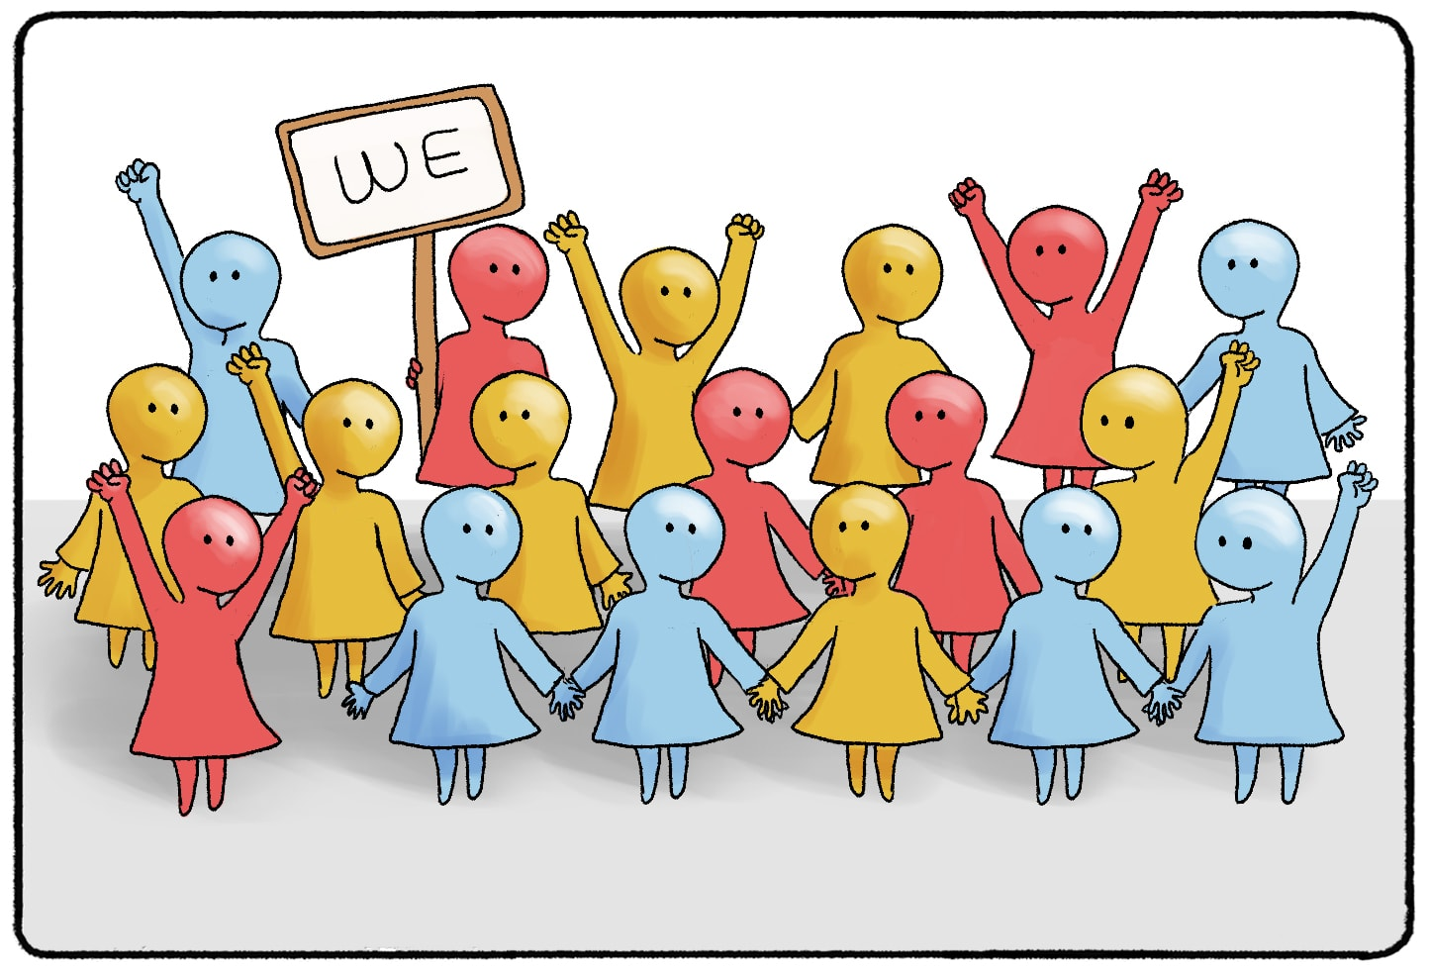

Slide 11
Social categorisation
The innate process of placing people we come across into groups based on shared characteristics.
If we deem they are similar to us they are part of our ingroup, if we deem they are different to us they are part of an outgroup.

Slide 12
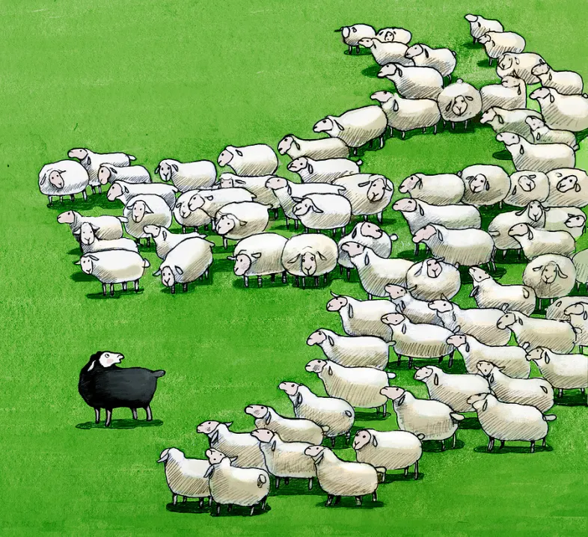

Slide 13
Ingroup and outgroup
Social Identity Theory proposes that members of an ingroup will stereotype members of outgroups by assuming all members of the outgroup are similar and will find ways to cast them in a poor light to boost their own self-image.

Slide 14


Slide 15
Tajfel and Turner explained how people moved through three cognitive stages when determining whether people were part of the ingroup or an outgroup
Social categorisation: categorising people based on shared characteristics, eg age, gender, race
Social identification: adopting the identity of the group that has been joined
Social comparison: comparing the joined group with other groups

Slide 16

To save on perception and time-consuming cognitive processing, people use social categorisation to group people, including themselves, based on shared characteristics. This often unconscious process helps people simplify and rapidly assess their social environment, but leads to prejudice, stereotyping and discrimination.

Slide 17

People tend to be members of multiple social groups and social categorisation helps people discover which groups they are part of or have an affinity with. Taking on the identity of a group involves confirming with particular social norms.

Slide 18

Now that people have social identities for the social groups they feel they belong to, they start to compare these groups with other outgroups. Social comparison is critical: the ingroup profile is more positive than the outgroup to maintain self esteem.

Slide 19

Comparisons are made when positive aspects are attributed to ingroups and negative aspects are attributed to outgroups internally (dispositional attribution). Negative aspects are attributed to ingroups and positive aspects are attributed to outgroups externally (situational attribution).

Slide 20

Social comparison leads to intergroup conflict.

Slide 21
Strengths and limitations of SIT
Strengths
Limitations
Explains why people feel more empathy toward people who they feel are similar to them.
Explains bias towards ingroups and against outgroups that often lead to conflict.
Claims that comparable groups are likely to experience conflict, but often cooperation is seen instead.
Does not address intergroup conflict based on competition for resources.

Slide 22
Success Criteria
Summarise Social Identity Theory
List positive and negative effects or examples of SIT
Define social categorisation
Define ingroup and outgroup

